Slide 1
How to install
By Leo

Slide 2
Step 1
Download the file(you have done this step aleady)

Slide 3
Step 2
Check to see if your web browser of choice is chromium based(if it is, proceed)

Slide 4
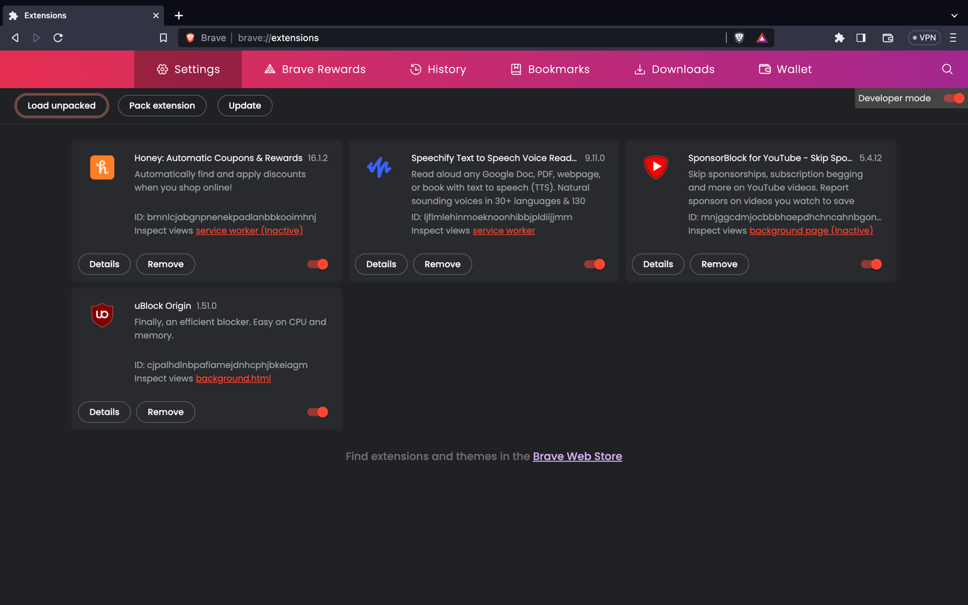
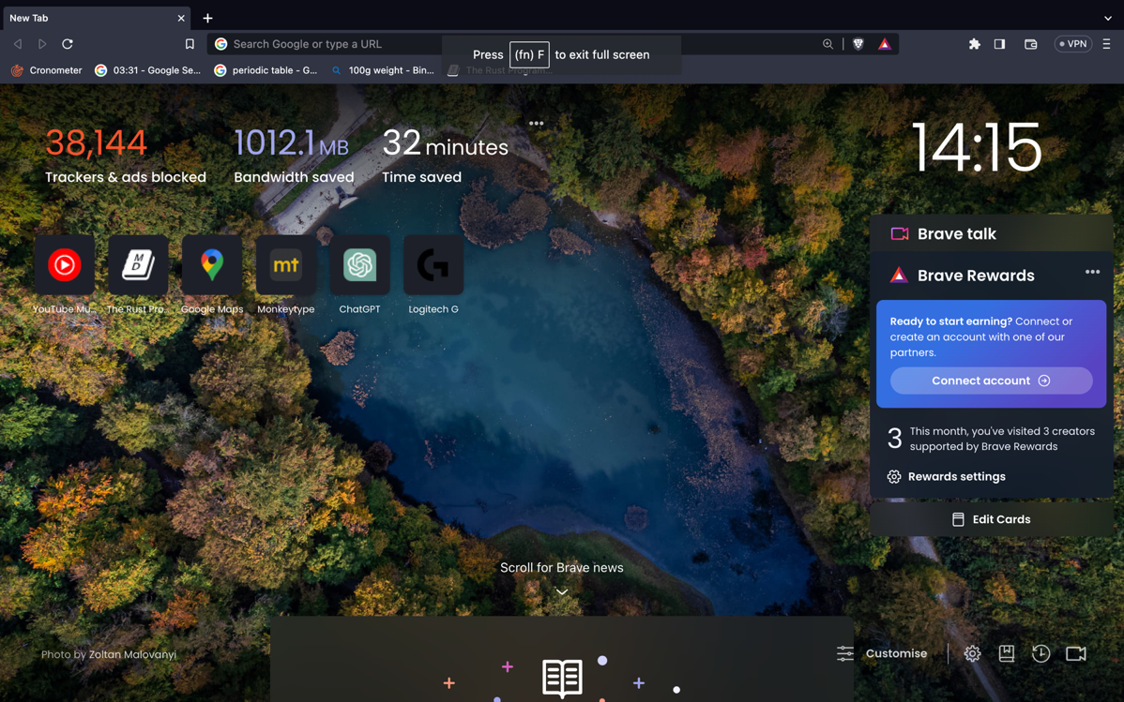
Steps 3-4
Click the puzzle icon(if you do not have it, open a new tab and type out chrome://extensions
(I am using brave browser, so for me it is brave://extensions, but chrome://extensions still works
Open your broswer

Slide 5
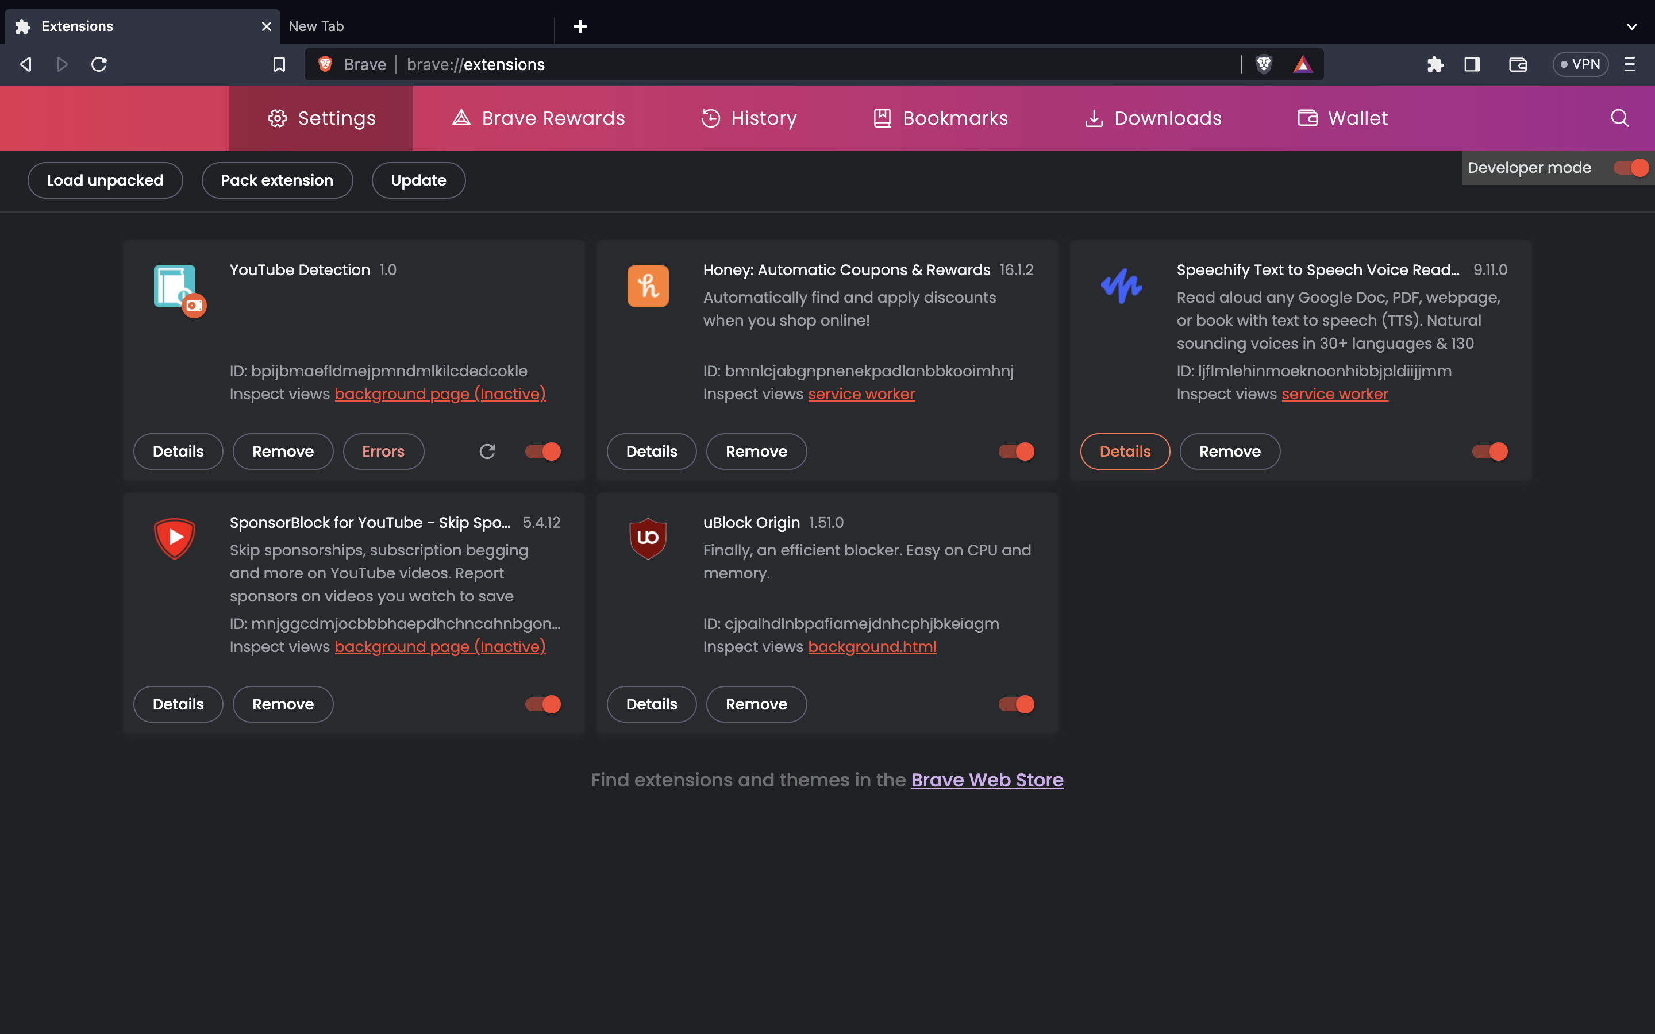

Step 5
Enable developer mode on your browser of choice by going to chrome://extensions and clicking on the slider on the top right of the screen

Slide 6
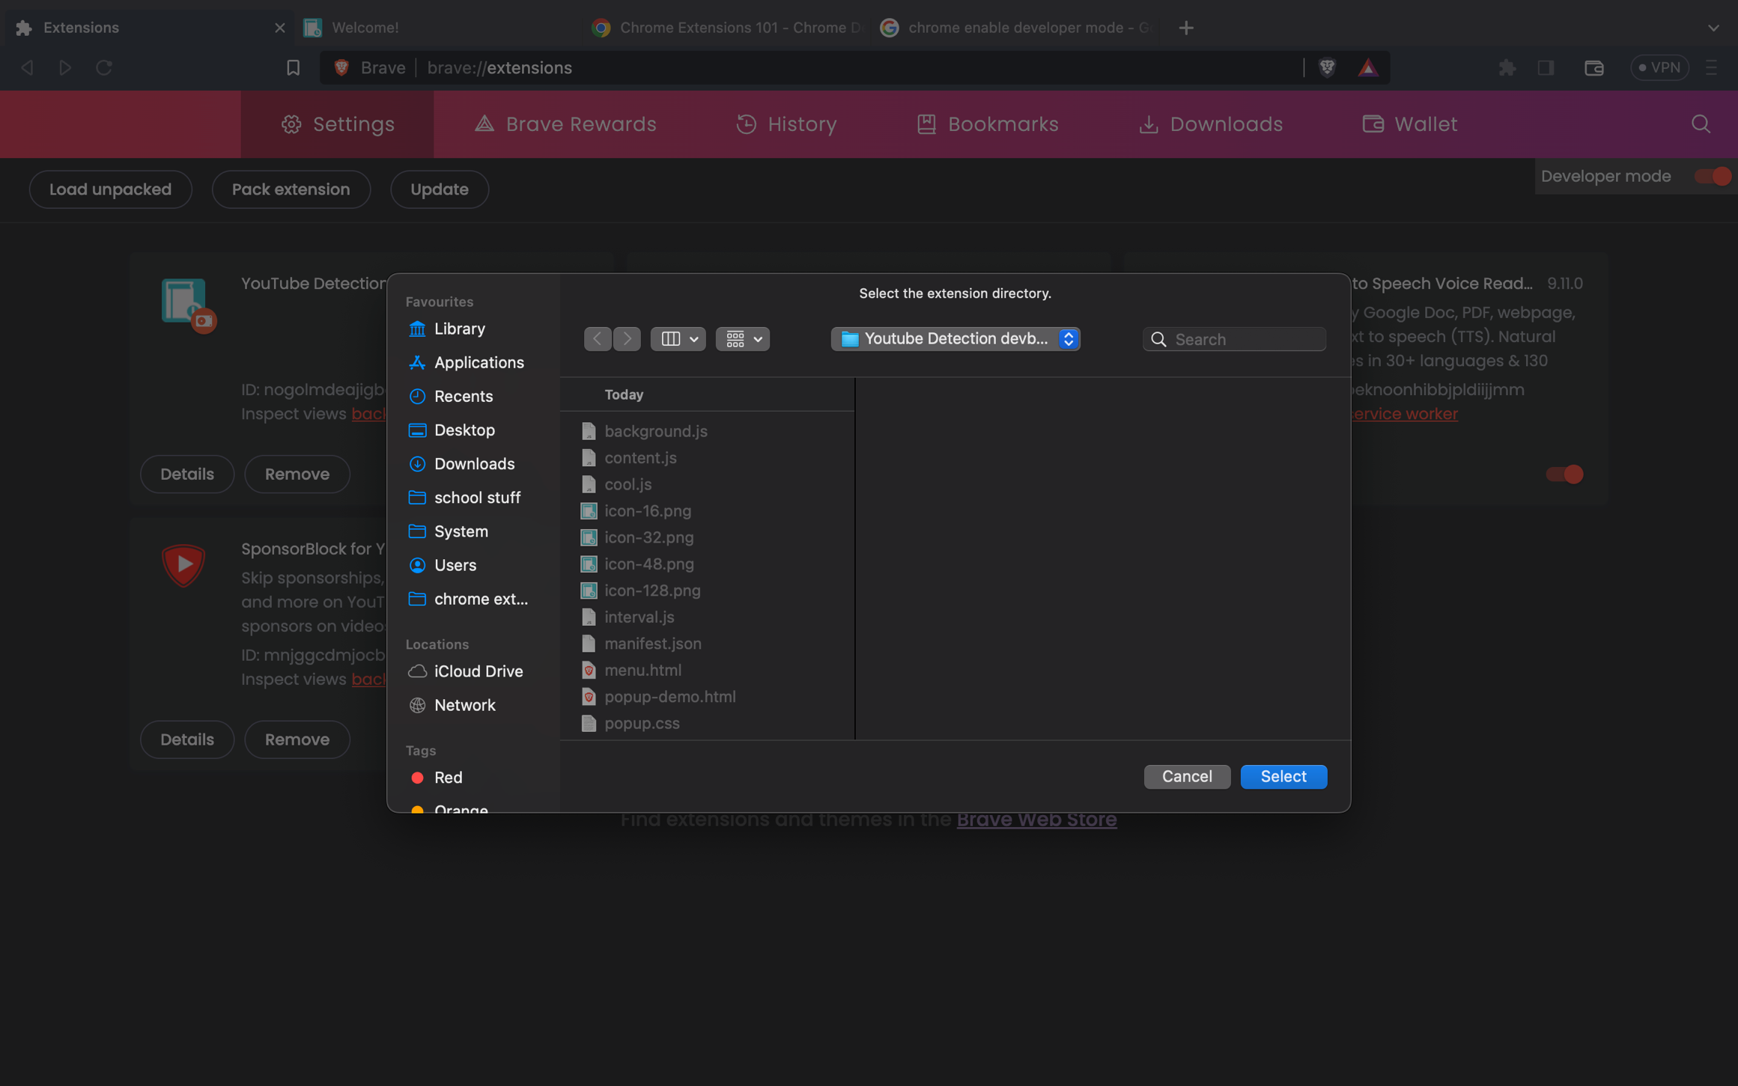
Step 6
Click Load Unpacked and select my extension (it’s in the folder this file was in)

Slide 7
Step 7
Use this while watching youtube and give me feedback on what I did right, what I did wrong, and how I can improve
Email: lzamo0@eq.edu.au

